Slide 1
Fake News Detection
MIE1624 Team 8 | December 3, 2019
Notes:
Kunal Bambardekar, 1005618002
Renu Indapurkar, 1005659039
Amr Mohamed, 999593079
Rafael Perez, 1006594641
Collin Wilson, 1002258175

Slide 2
What can preliminary data analysis tell us?

Slide 3
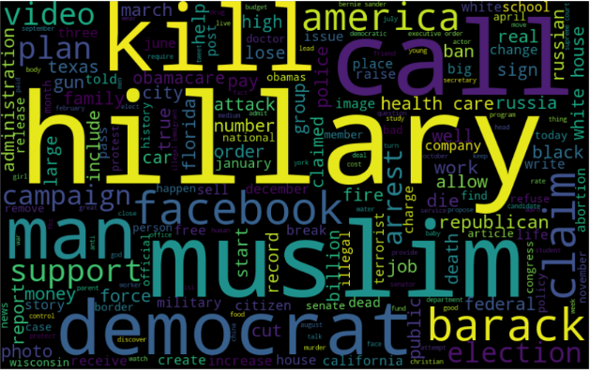
These words are most associated with false claims

Slide 4
What can machine learning tell us?

Slide 5
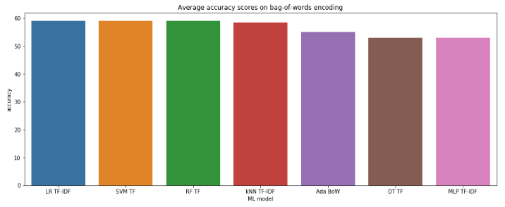
Logistic Regression, Linear Support Vector Machines, and Random Forest achieve 59% average accuracy

Slide 6
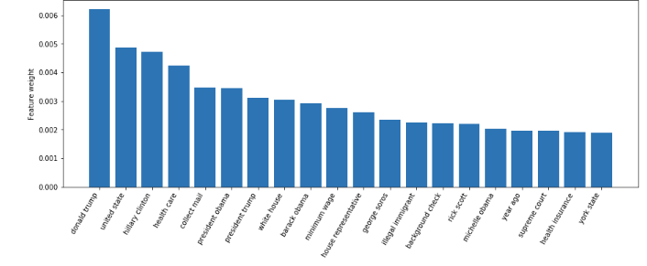
Random Forests feature importance can tell us which issues were most discussed

Slide 7
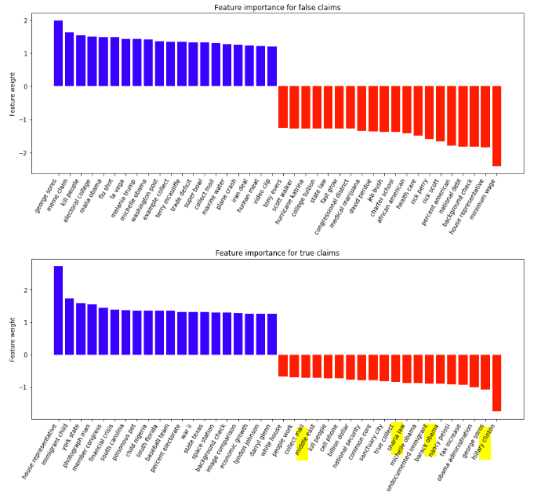
Logistic Regression can tell us which features factor more in determining whether a claim is true or false

Slide 8
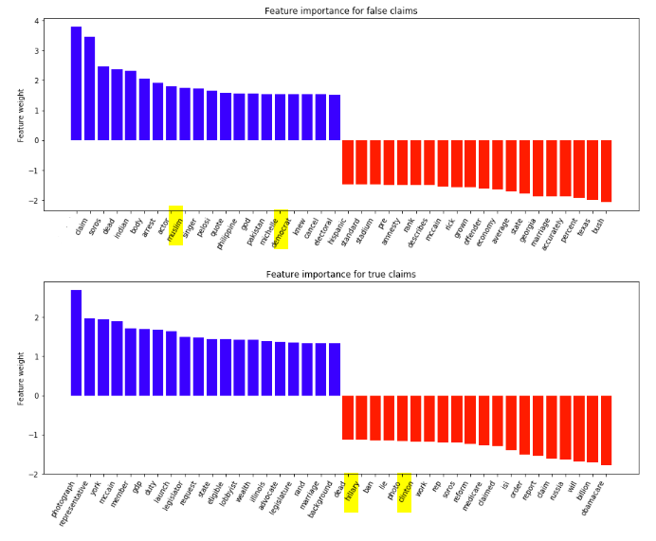
False
muslim
democrat
True
hillary
clinton
Logistic Regression can tell us which features factor more in determining whether a claim is true or false

Slide 9
False
george soros
kill people
True
hillary clinton
barack obama
Logistic Regression can tell us which features factor more in determining whether a claim is true or false

Slide 10
Where is the model slacking?

Slide 11
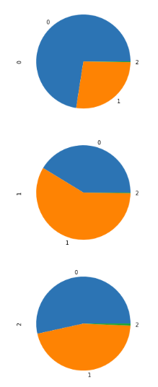
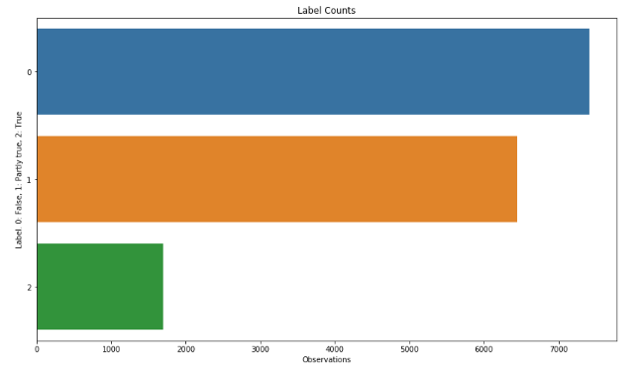
The truth is scarce...
False
Partly True
True

Slide 12
fin

